Slide 1
MINI-HOMEWORK 1
LUCA PAGLIARELLO
MATRICOLA: 1000044655
https://www.vinted.it/

Slide 2


Slide 3
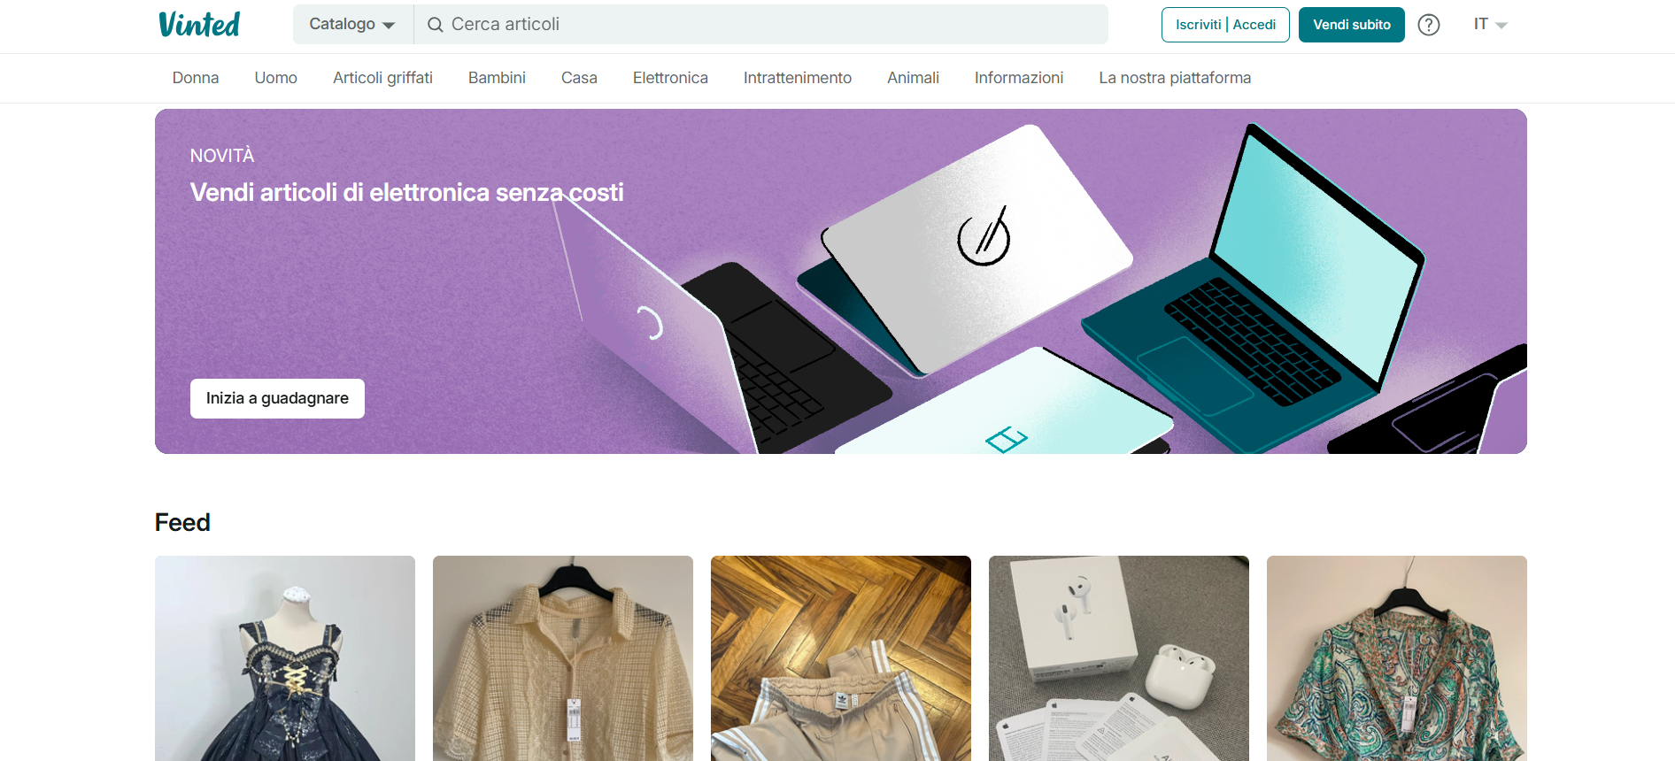
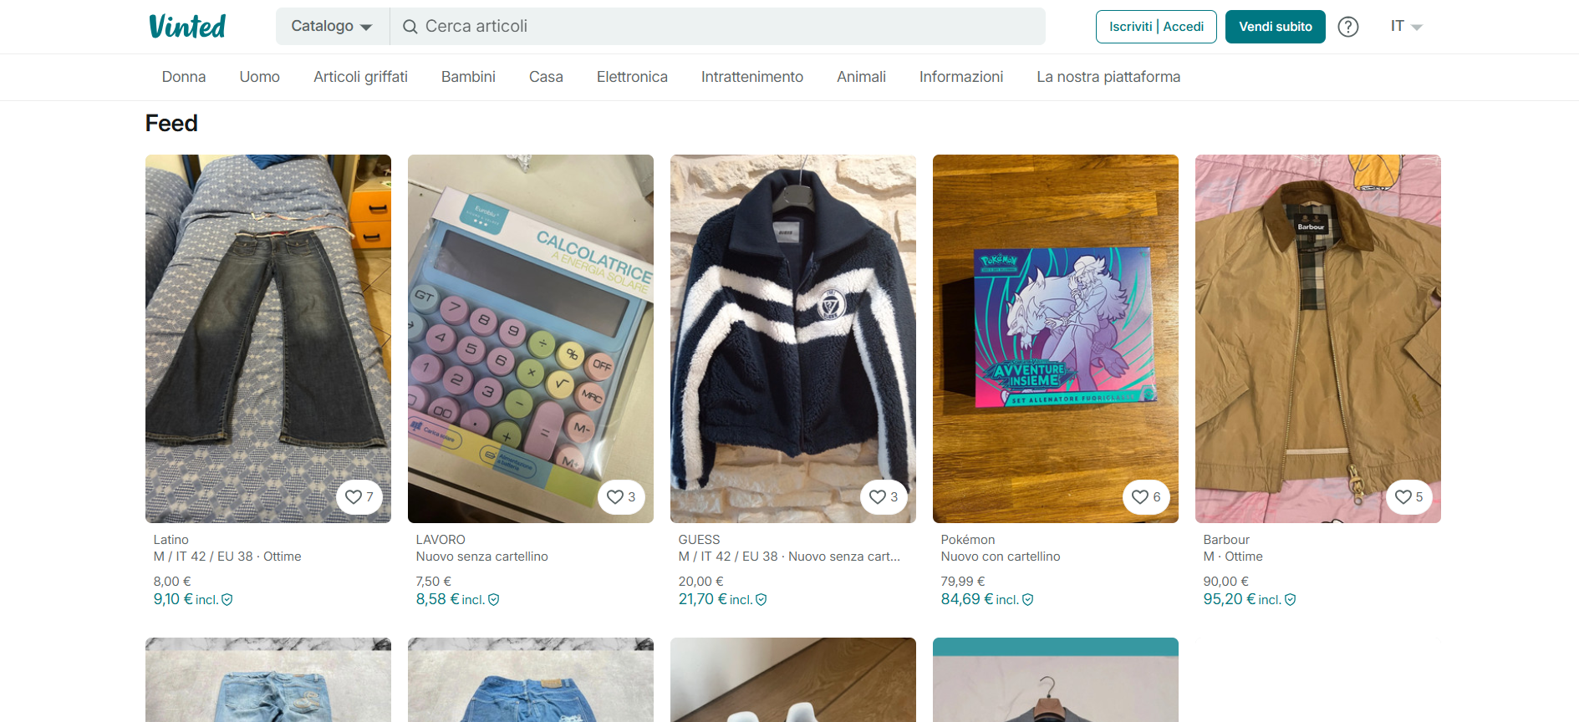

Slide 4
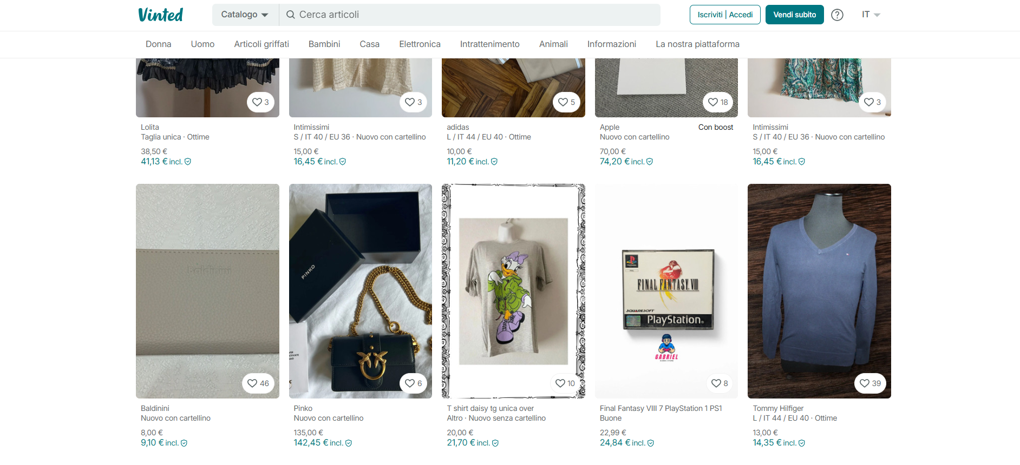

Slide 5
